Slide 1

Bhealthy
Fitness starts with what you eat
Joseph Green st20152142, Fahim Ahmed st20187784, Tausif Meah st20182639, Omaima Ben Ayzah st20158659, Ephraim Olajide Abimbola Omomowo st20171486

Slide 2
Aims & Objectives
Use research to compare against competitors
Create an app to promote healthy lifestyles among university students
Create strategies to ensure the longevity of the app
Aims
Objectives
Use mobile/web applications such as mobile app stores to gain an understanding
Use Bubble.io to create an interactive interface to show the functionality and design of the app
Contact fitness influencers and create ads to increase users for the app

Slide 3
Why is this needed?
Obesity rates are rising
Since Covid people are becoming more health conscious
It is estimated that illnesses associated with obesity cost the Welsh NHS more than £73m a year (NHS wales 2018)
While there are fitness apps available, none from our research focus on students
Therefore, we have identified a niche in the market
Notes:
- Obesity rates are rising, its becoming a national health crisis that cannot be ignored
COVID has made us realise how important our health is, with 73.2% of those becoming critically ill or dying being overweight or obese (WHO 2021)

Slide 4
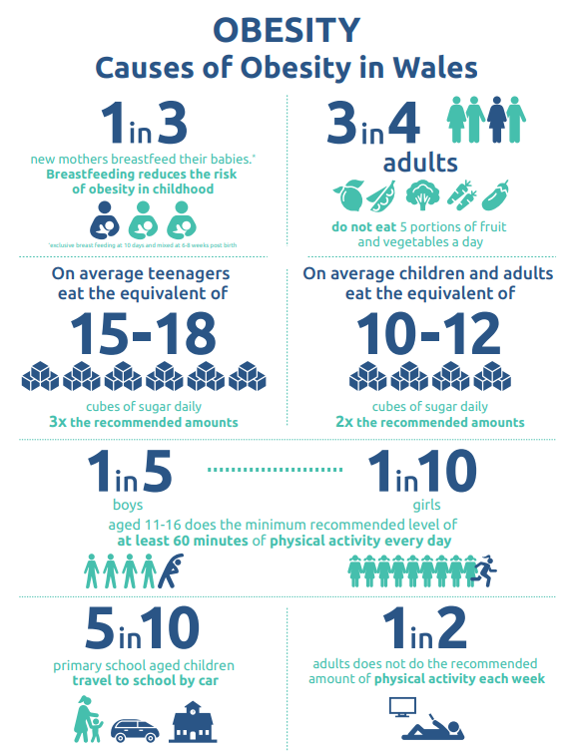
NHS Wales (2018)

Slide 5
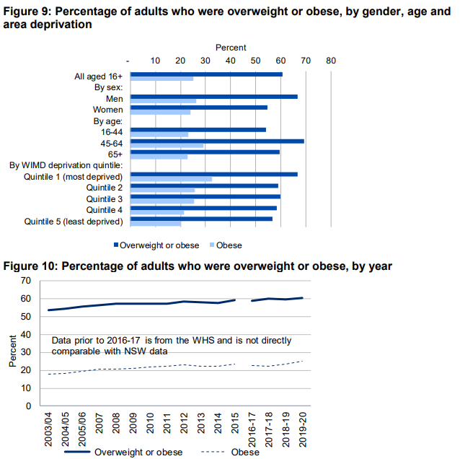
The National Survey for Wales (2020)

Slide 6
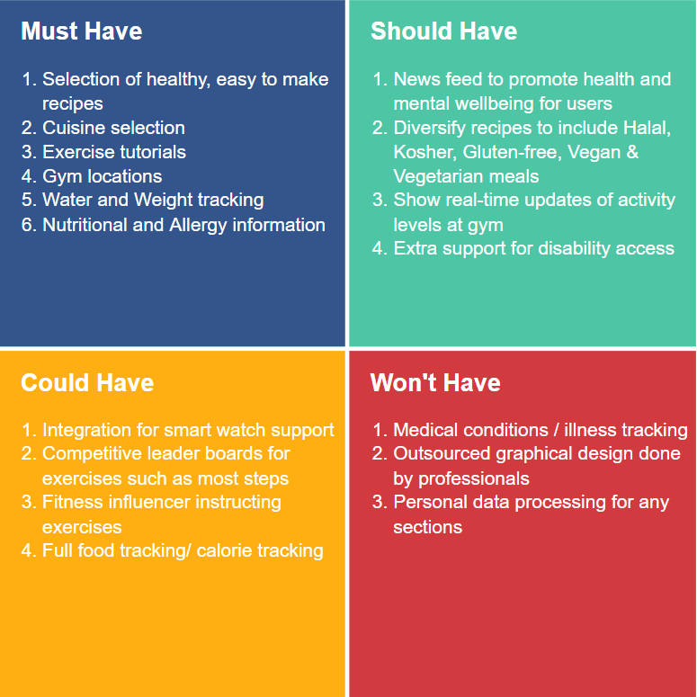

Slide 7
System Design
A wireframe is a schematic or blueprint that is useful for helping you, your programmers and designers think and communicate about the structure of the software or website you're building (balsamiq.com, 2020).
A wireframe was created for our Bhealthy app.
Recipes Tab – when clicked a list of cuisines will be displayed. User chooses and a list of recipes will be shown with the nutritional information
Journal tab – user keeps a record of weight and water intake in a bar chart
Exercise tab – links of exercises user can do targeting the specific area they want to train.
Gyms tab – map imported , displays list of gyms in their area.

Slide 8
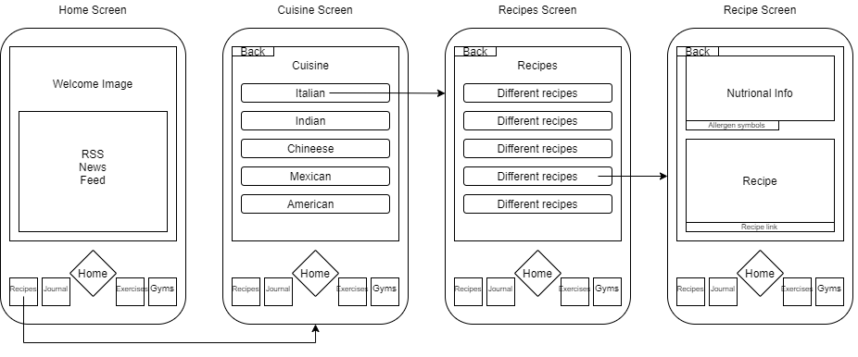
Wireframes

Slide 9
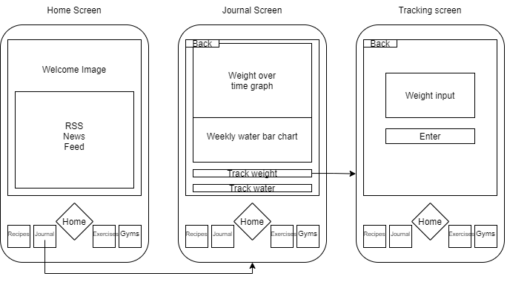
Wireframes

Slide 10
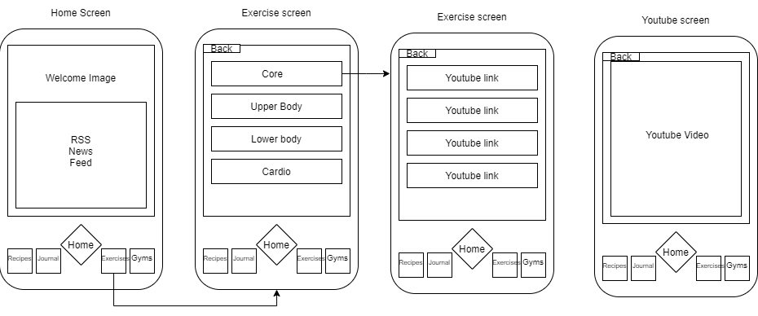
Wireframes

Slide 11
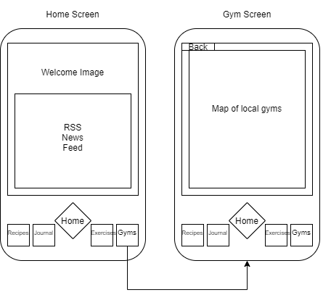
Wireframes

Slide 12

But what else is out there?
MyFitnessPal
Massively popularity/brand recognition
Can track food with nutritional values, exercise and weight
Social media aspects where people can post and comment
Disadvantages
Not tailored to students
Doesn’t provide recipes
Doesn’t locate nearby gyms
MyFitnessPal (2022)

Slide 13

But what else is out there?
Jefit
Can track workouts in depth
Can track weight, progress pictures etc
Social media aspects
Disadvantages
No food tracking
Annoying popup ads
Jefit (2022)

Slide 14
Risk Register
A risk register is described as a document that is used as a risk management tool to identify potential setbacks within a project. This process aims to collectively identify, analyze, and solve risks before they become problems (Asana, 2021).
Before we started our project, we created our own risk register shown in the next slide

Slide 15
Current Status | Risk Impact | Probability of occurrence | Risk description | Project impact | Risk response
open | High | High | Not all group members available at the same time. | Some parts of the project may not be completed within the given time. | Before the project was started, we created a Gantt which shows the timeframe in which different objectives should be achieved.
open | Medium | Medium | Functions of the app may not work. | If the app does not work as it, should it would be a problem for the user. | Before we launch the app, we will ensure to use different methods of software testing.
open | Low | Low | Some members of the group may not have a particular skill set to complete different areas of the work. | Areas of the app maybe unfinished or not completed to high standards. | Delegate roles to team members who have experience in the area. They can also train group members so they can broaden their skillset.
open | High | Medium | Project budget maybe cut at any time if investors decide to pull out last minute. | App may have less features and take a longer time to complete. | Have weekly meeting meetings with stakeholders so they are informed on what the money is being spent on
open |  | Medium/High | Project length maybe overrun | Not completed within the time frame | Refer to Gantt chart to see if the objectives are being met.

Slide 16
Gantt Chart.
A Gantt chart is a project management tool that illustrates a project plan (Atlassian, 2022)
This is vital we create a Gantt chart so that we know exactly what we are doing at each stage and how long it will take to achieve our goals and objectives when creating the app

Slide 17
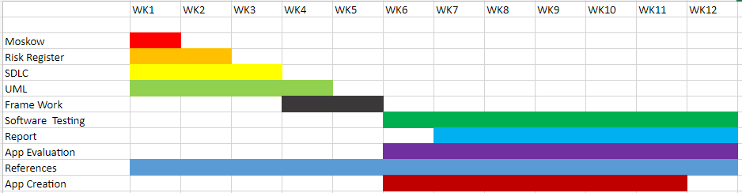
Gantt Chart.
The color coding on the Gantt chart represent how long each section of the planning and execution would take.
We delegated roles between our team members to complete each section.
Note this is a rough estimation, some task would either overlap or finish quicker than anticipated.
This is good as if some members of the team are behind they can get help.

Slide 18
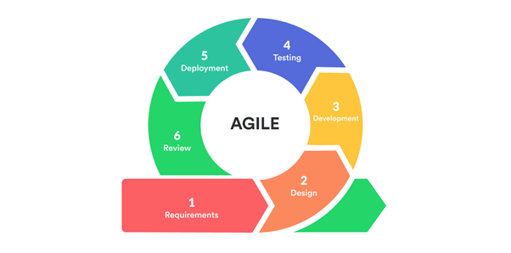
OUR Approach to the development
Incremental model
Customer centric
Improve organizational synergy
Scrum framework
Global pricing (2021)
Notes:
Agile methodology is an incremental project management model, which means software is produced in incremental, rapid cycles.
If the customer has any feedback or any change in the feature, then it can be accommodated in the current release of the product.
An Agile approach can improve organizational synergy by breaking down organizational barriers and developing a spirit of trust and partnership around organizational goals.

Slide 19
WHY AGILE SCRUM METHODOLOGY?
A "process framework": a set of small development cycles (sprints) that must be completed on time
Iterative and incremental practices to increase productivity, quality and reduce time
Continuous and regular collaboration with the client and stakeholders
Allow changes throughout the process
Presence of a "scrum master" who is responsible for making the process run smoothly

Slide 20
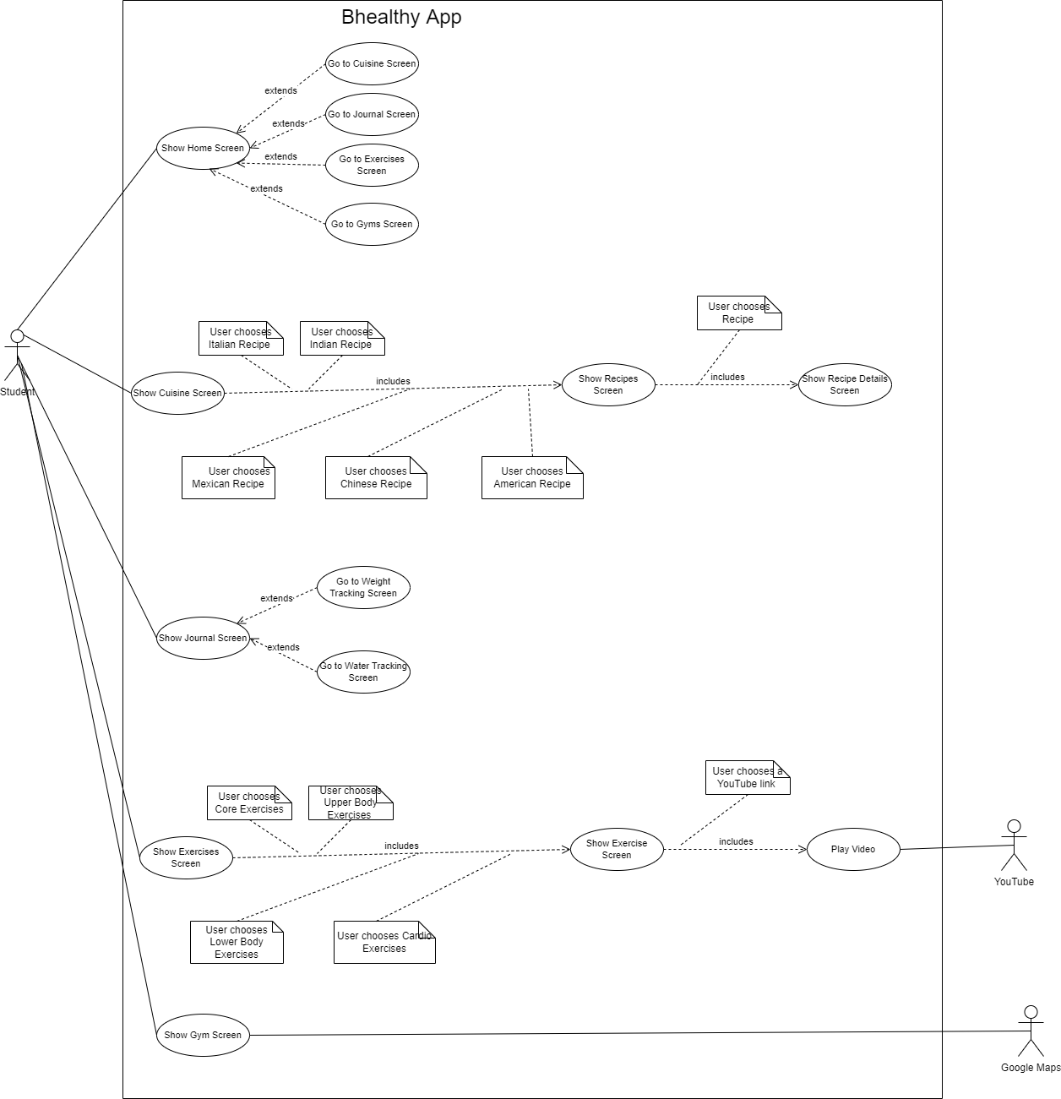
Notes:
Use case diagram

Slide 21
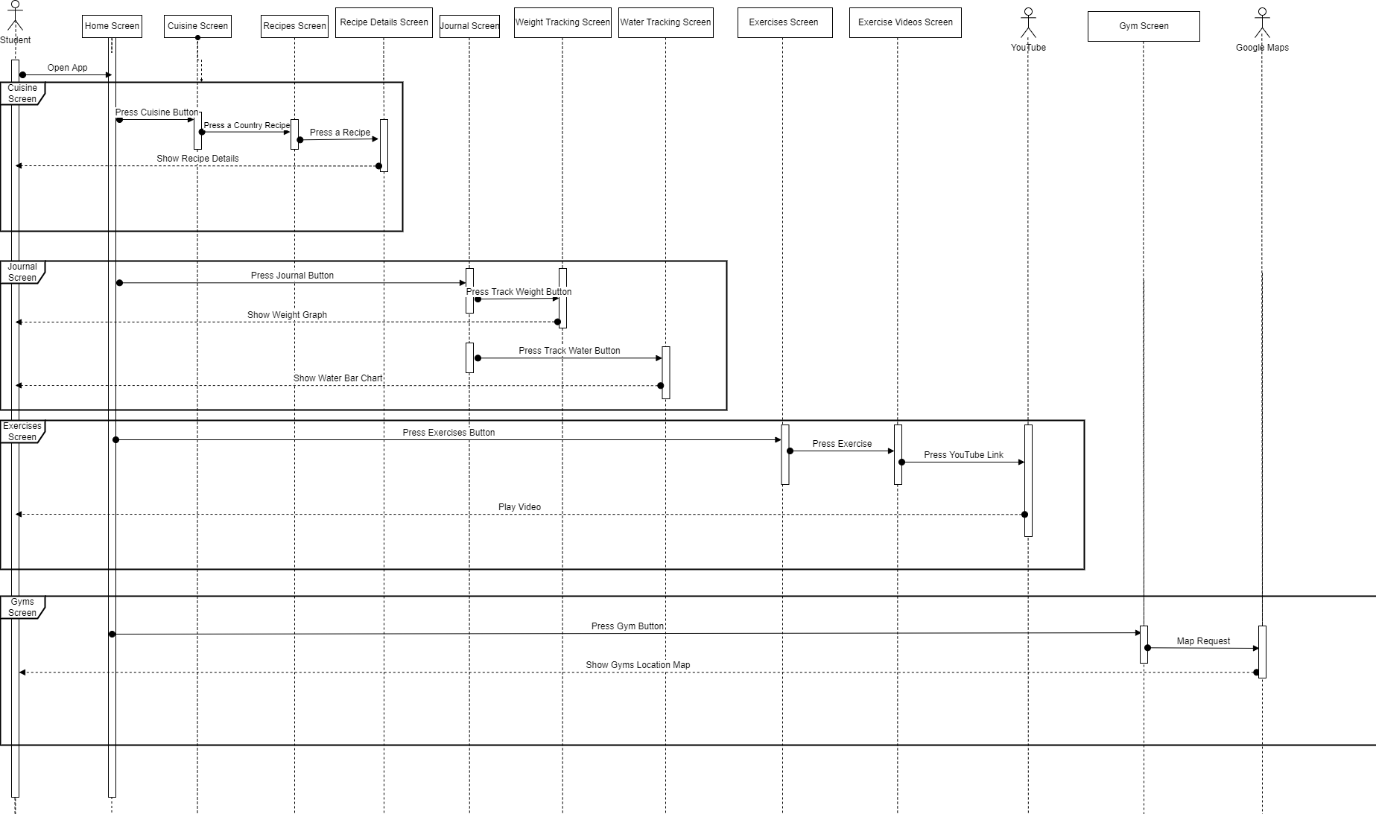
Notes:
Sequence diagram

Slide 22
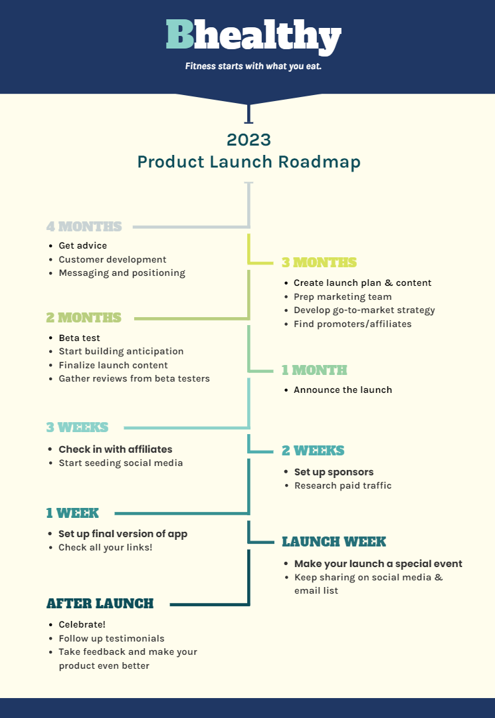
Product roadmap

Slide 23

Why we chose to develop in Bubble.io
Bubble.io
Free to use
Ease of use due to no coding
Quick prototyping
Lots of support documentation
Support of multiple platforms
Large library of APIs
Scalability
Vs Traditional app coding
More access
Longer time to develop therefore costlier
No preview UI
Bubble.io (2022)

Slide 24
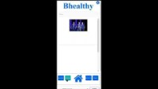

Slide 25
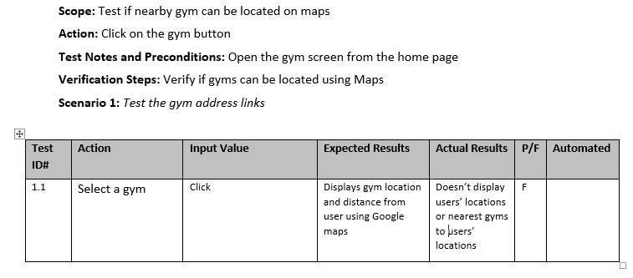
Software testing

Slide 26
Conclusion
Health has become a big concern for some people
Students will always exist so there will be a constant demand for our product
Clear niche in the market
Room for growth in the long term
Our app is easy and reasonably quick to develop and change
Using bubble.io our app will be completed within the given deadline
Notes:
where we are aiming to target students struggling with their health

Slide 27
References
NHS Wales. (2018). The case for action on obesity in Wales. Available at: http://www.wales.nhs.uk/sitesplus/documents/888/150119%20The%20case%20for%20action%20on%20obesity%20in%20Wales%200ae%20FINAL1.pdf [Accessed: 24/02/2022]
The National Survey for Wales. (2020). National Survey for Wales 2019-20: Adult lifestyle. Available at: https://gov.wales/sites/default/files/statistics-and-research/2020-07/adult-lifestyle-national-survey-wales-april-2019-march-2020-390.pdf [Accessed: 24/02/2022]
MyFitnessPal. (2022). MyFitnessPal. Available at: https://www.myfitnesspal.com/ [Accessed: 24/02/2022]
Jefit. (2022). Jefit. Available at: https://www.jefit.com/ [Accessed: 24/02/2022]
Bubble.io. (2022). Bubble.io. Available at: https://bubble.io/home (Accessed: 24/02/2022)
TestingXperts. (2021). Types of Software Testing You Should Know. Available at: https://www.testingxperts.com/blog/types-of-software-testing [Accessed on 17/2/2022]
Cprime. (2022). What is Agile? What is Scrum? Available at: https://www.cprime.com/resources/what-is-agile-what-is-scrum/ [Accessed on 15/3/2022]
balsamiq.com. (n.d.). What Are Wireframes? | Wireframing Academy | Balsamiq. [online] Available at: https://balsamiq.com/learn/articles/what-are-wireframes/.
‌Asana (2021). What Is a Risk Register: A Project Manager’s Guide with Examples • Asana. [online] Asana. Available at: https://asana.com/resources/risk-register.
‌Atlassian (n.d.). What is a Gantt chart? [online] Atlassian. Available at: https://www.atlassian.com/agile/project-management/gantt-chart#:~:text=A%20Gantt%20chart%20is%20a.

Slide 28

Thank You
Any questions?

